Slide 1



Analyzing Crypto Currency Markets: Data Repository, Predictive Modeling, and Strategic Insights
Mid-semester presentation
Mid Semester Presentation
vENKATA anIL kUMAR pOKA

Slide 2

Project Overview
In order to facilitate the storing of cryptocurrency data in a local or cloud-based data warehouse, the project intends to develop a centralised Crypto Currency Data Repository. This data is made easily accessible for examination after it has been processed and cleaned, giving interested parties valuable information about the cryptocurrency market. The initiative also aims to use historical market data to develop a predictive analytics model. This model will evaluate patterns, trends, and market behaviours using machine learning algorithms, allowing stakeholders to forecast future market movements, price fluctuations, and investment opportunities.

Slide 3

Dataset
The CoinCap API, notably the endpoint that gives information on assets such as Bitcoin, is the data source utilized in this project.
API Endpoint: https://api.coincap.io/v2/assets
The API provides the following JSON response:
[{"id":"bitcoin","rank":"1","symbol":"BTC","name":"Bitcoin","supply":"19618343.00000000000
00000","maxSupply":"21000000.0000000000000000","marketCapUsd":"835435777974.41834
95482836470","volumeUsd24Hr":"4760159036.3792827873026213","priceUsd":"42584.42101
73315019290","changePercent24Hr":"1.0956691070429600","vwap24Hr":"42945.4716425937
635244","explorer":"https://blockchain.info/"}]

Slide 4
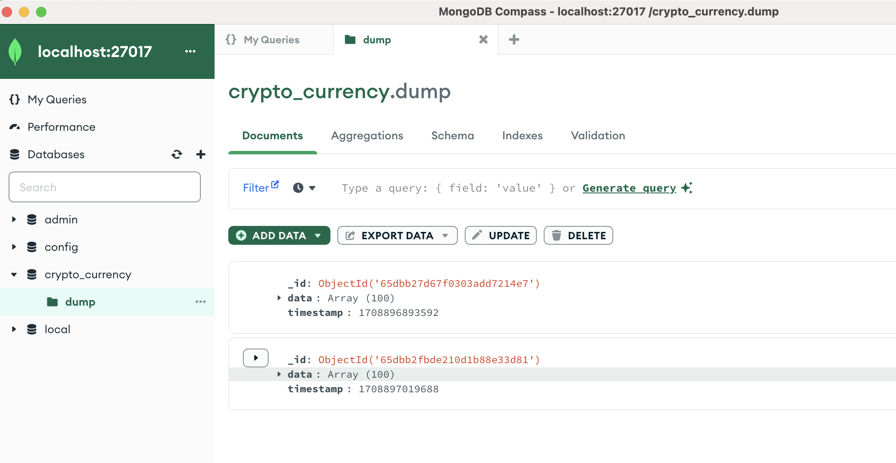
Mongo DB home page

Slide 5
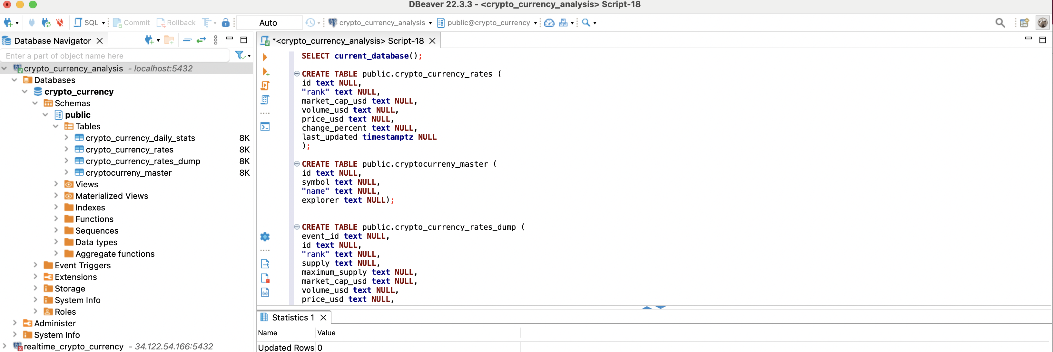
Postgres SQL home page

Slide 6
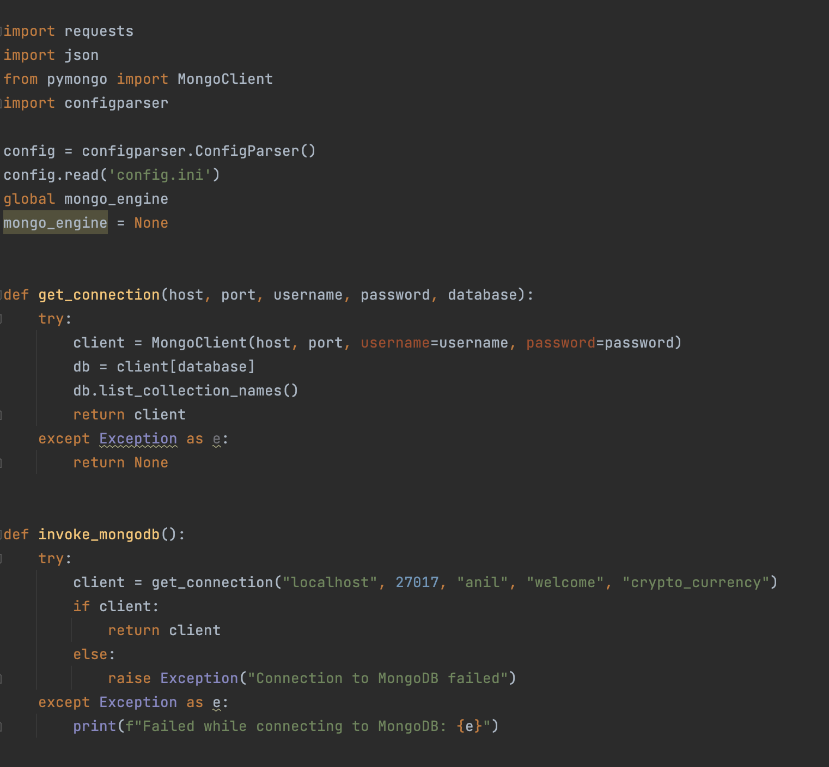
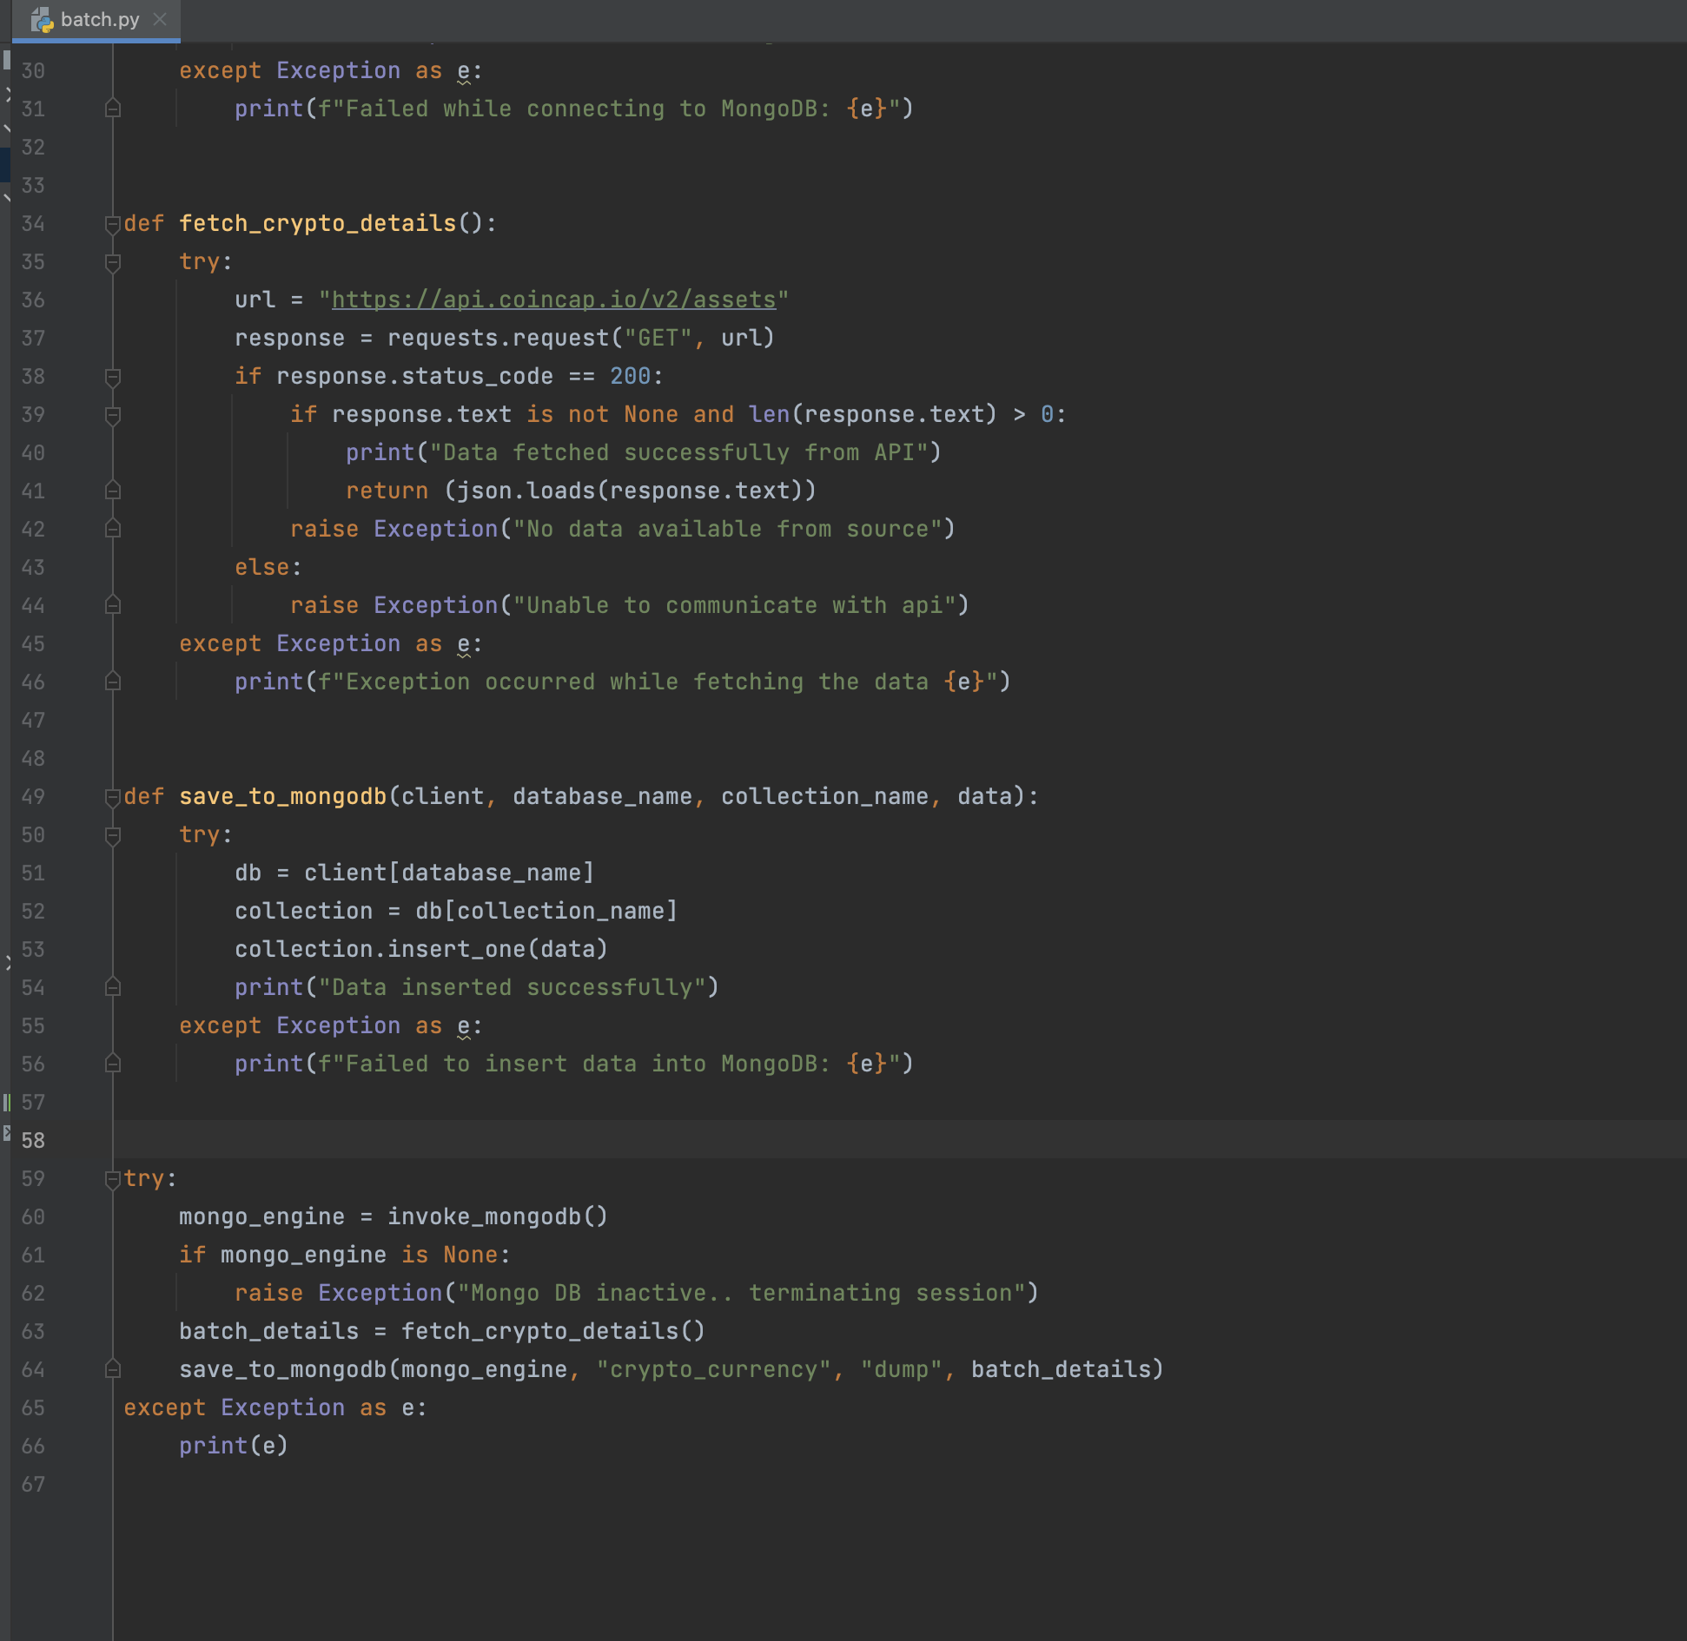
Batch – 1 ( dATA Pipeline from API TO MONGODB)

Slide 7
Scheduling CRON BATCH
* * * * * /usr/bin/python3 ./batch.py >> ./logfile.log 2>&1

Slide 8

Thank you

